Slide 1
Small area estimation of zero-inflated forest biomass
Josh Yamamoto
JSM 2024 Portland, Oregon August 5, 2024
Notes:
I work for redcastle resources (work done in collaboration with kelly, grayson, george, and others)

Slide 2
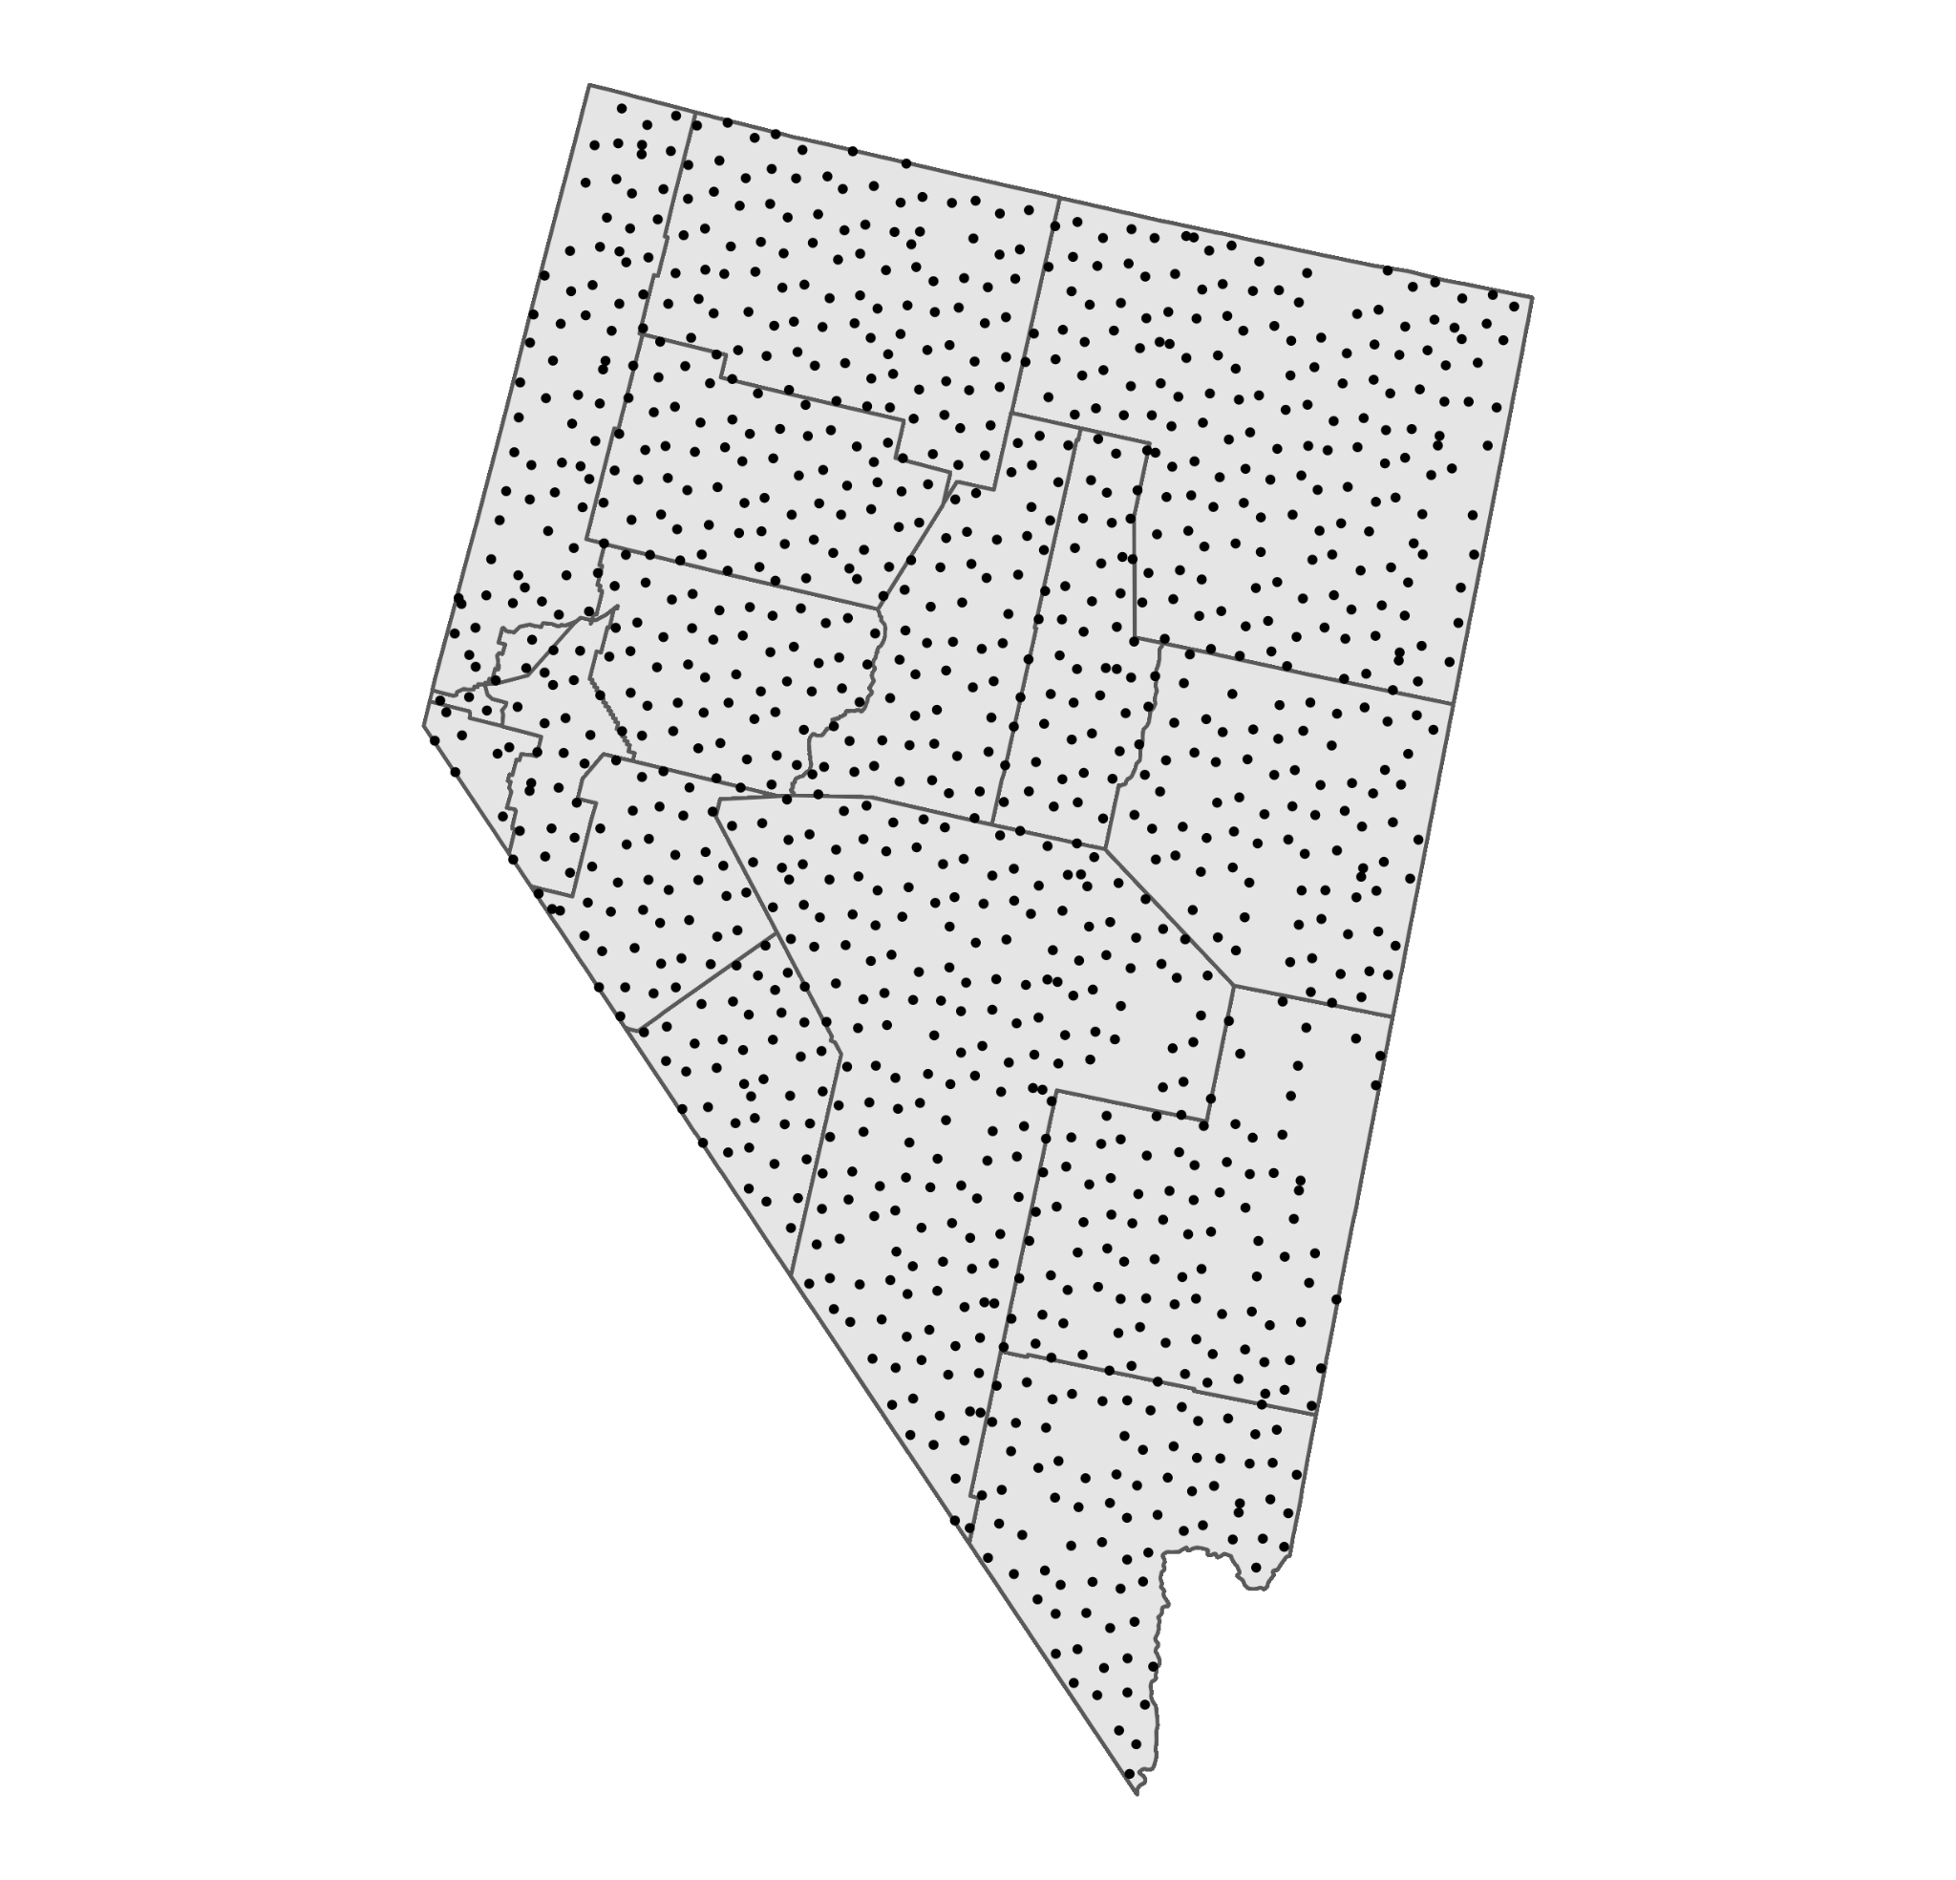
Forest Inventory & Analysis
Program (FIA)
FIA plots measured in 2019 in Nevada, USA
FIA Program is the strategic nationwide forest inventory of the United States
FIA collects data at permanent sample locations (plots) spaced across the U.S according to an equal probability quasi-systematic sampling design.

Slide 3
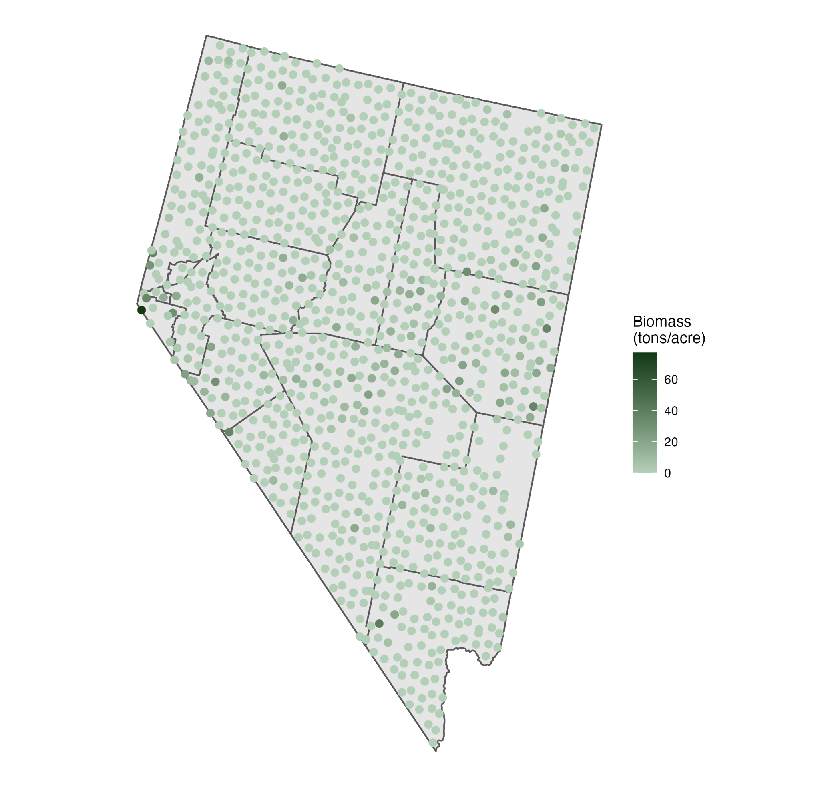
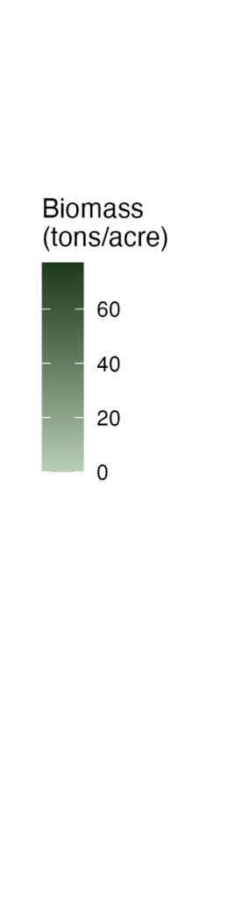

Slide 4
Zero-Inflation
(in forest attributes)

Slide 5

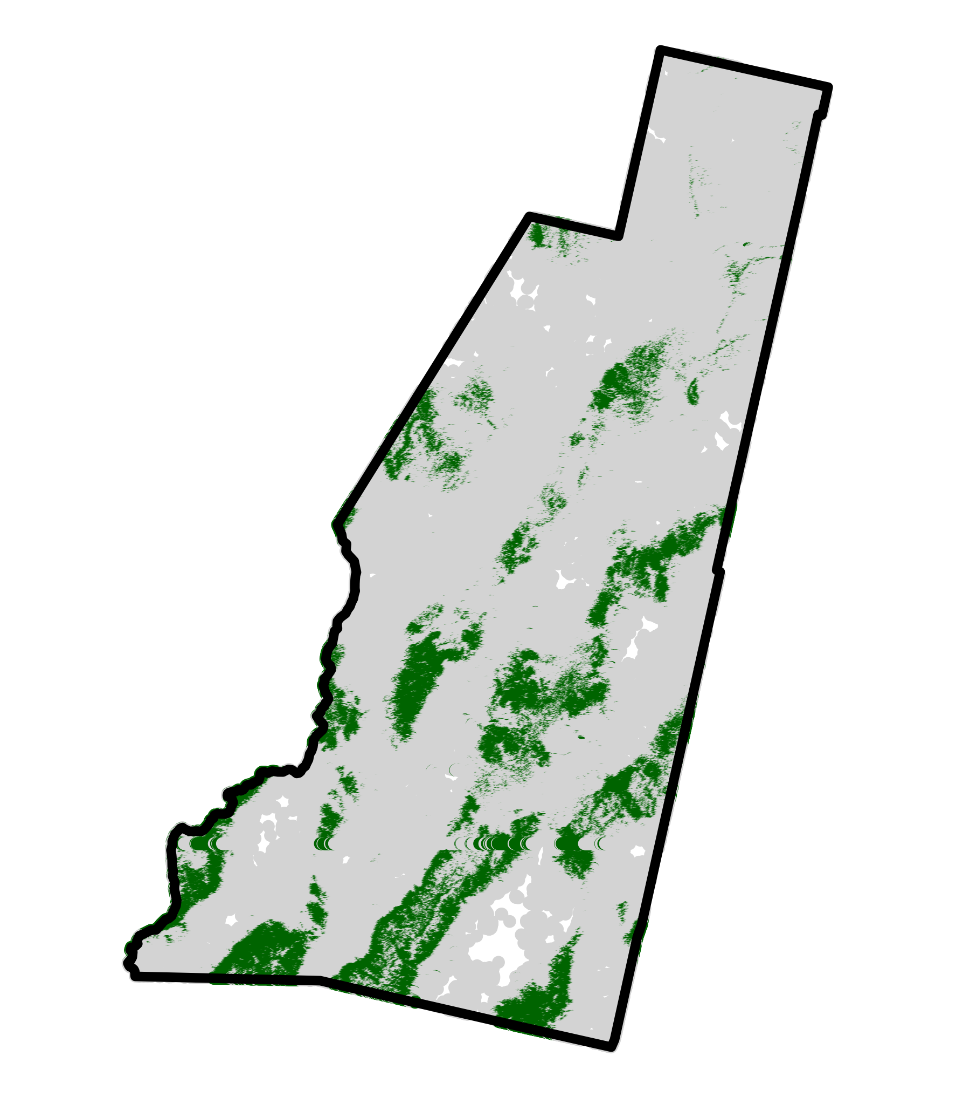
Lander County, NV
Sometimes key forest attributes are zero on a large number of plots for an area of interest.
Usually when an area of interest has little forest area.

Slide 6
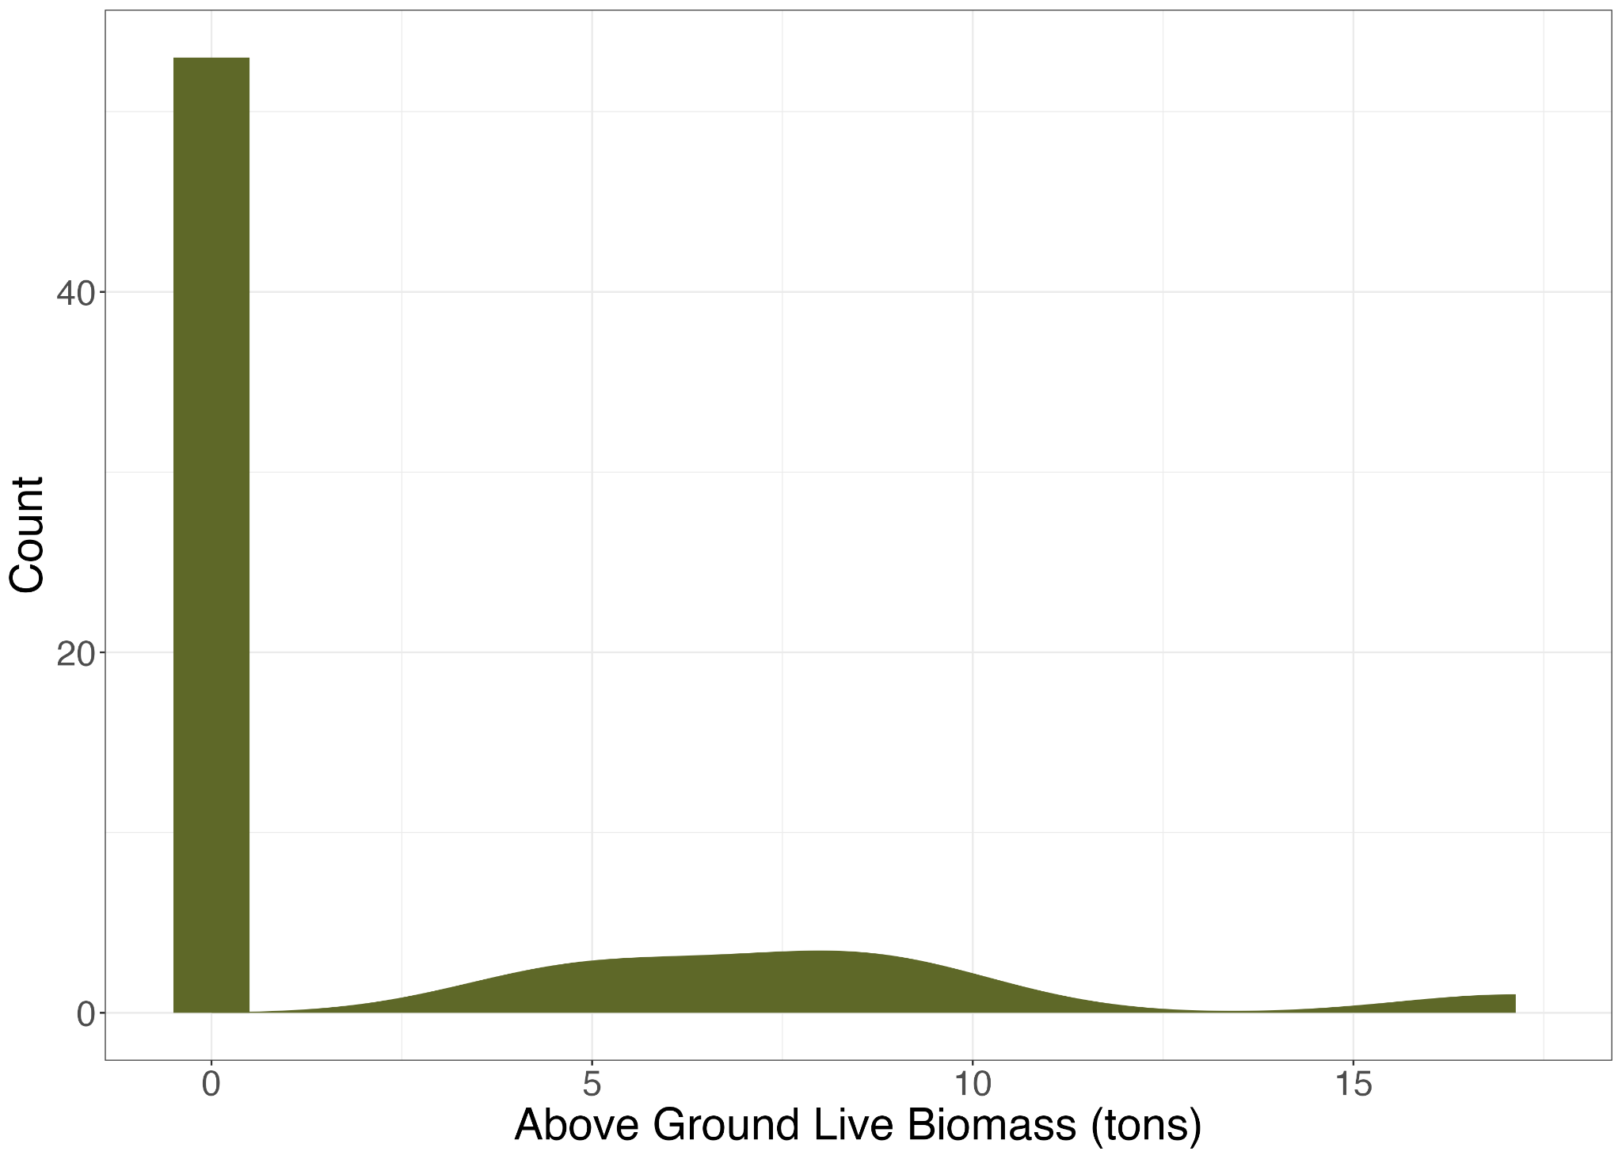
Distribution of biomass from 2019 Lander County FIA plots

Slide 7
Common Estimators
Post-Stratified
Uses a single categorical auxiliary variable
Weighted average of post-stratified means
Area-level linear mixed model
Linear model fit to domain-level means with domain-level random effects
Unit-level linear mixed model
Linear model fit to plot-level data with domain-level random effects
Aggregated to get domain-level estimates

Slide 8
Issues with existing estimators
Post-Stratified
Already in a setting where we worry about the variance of direct design based estimators.
Area-Level Linear Mixed Model
Usually good model fit, but doesn’t leverage all of the rich auxiliary data.
Unit-Level Linear Mixed Model
Model misspecification

Slide 9
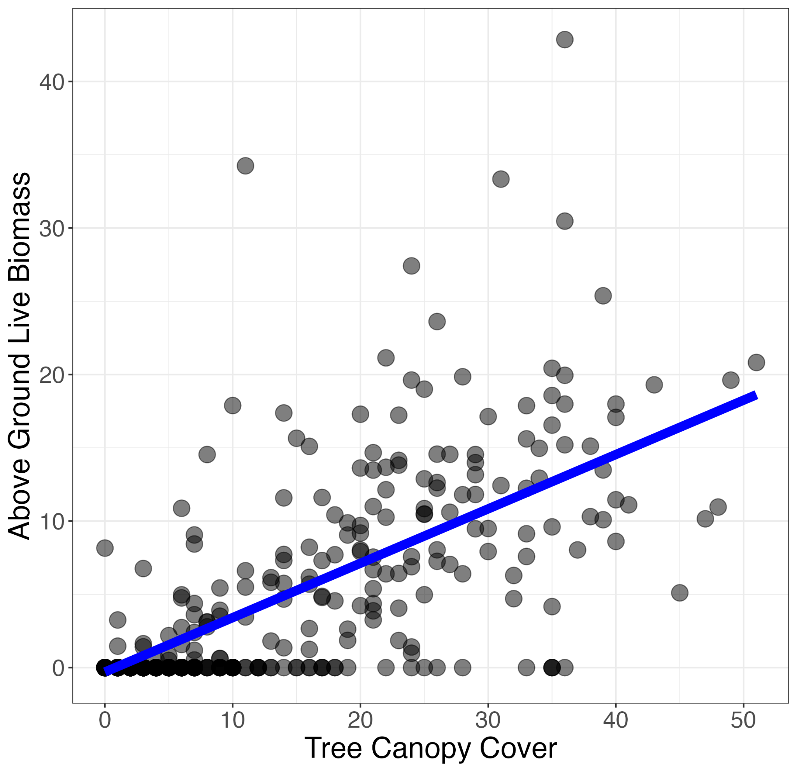
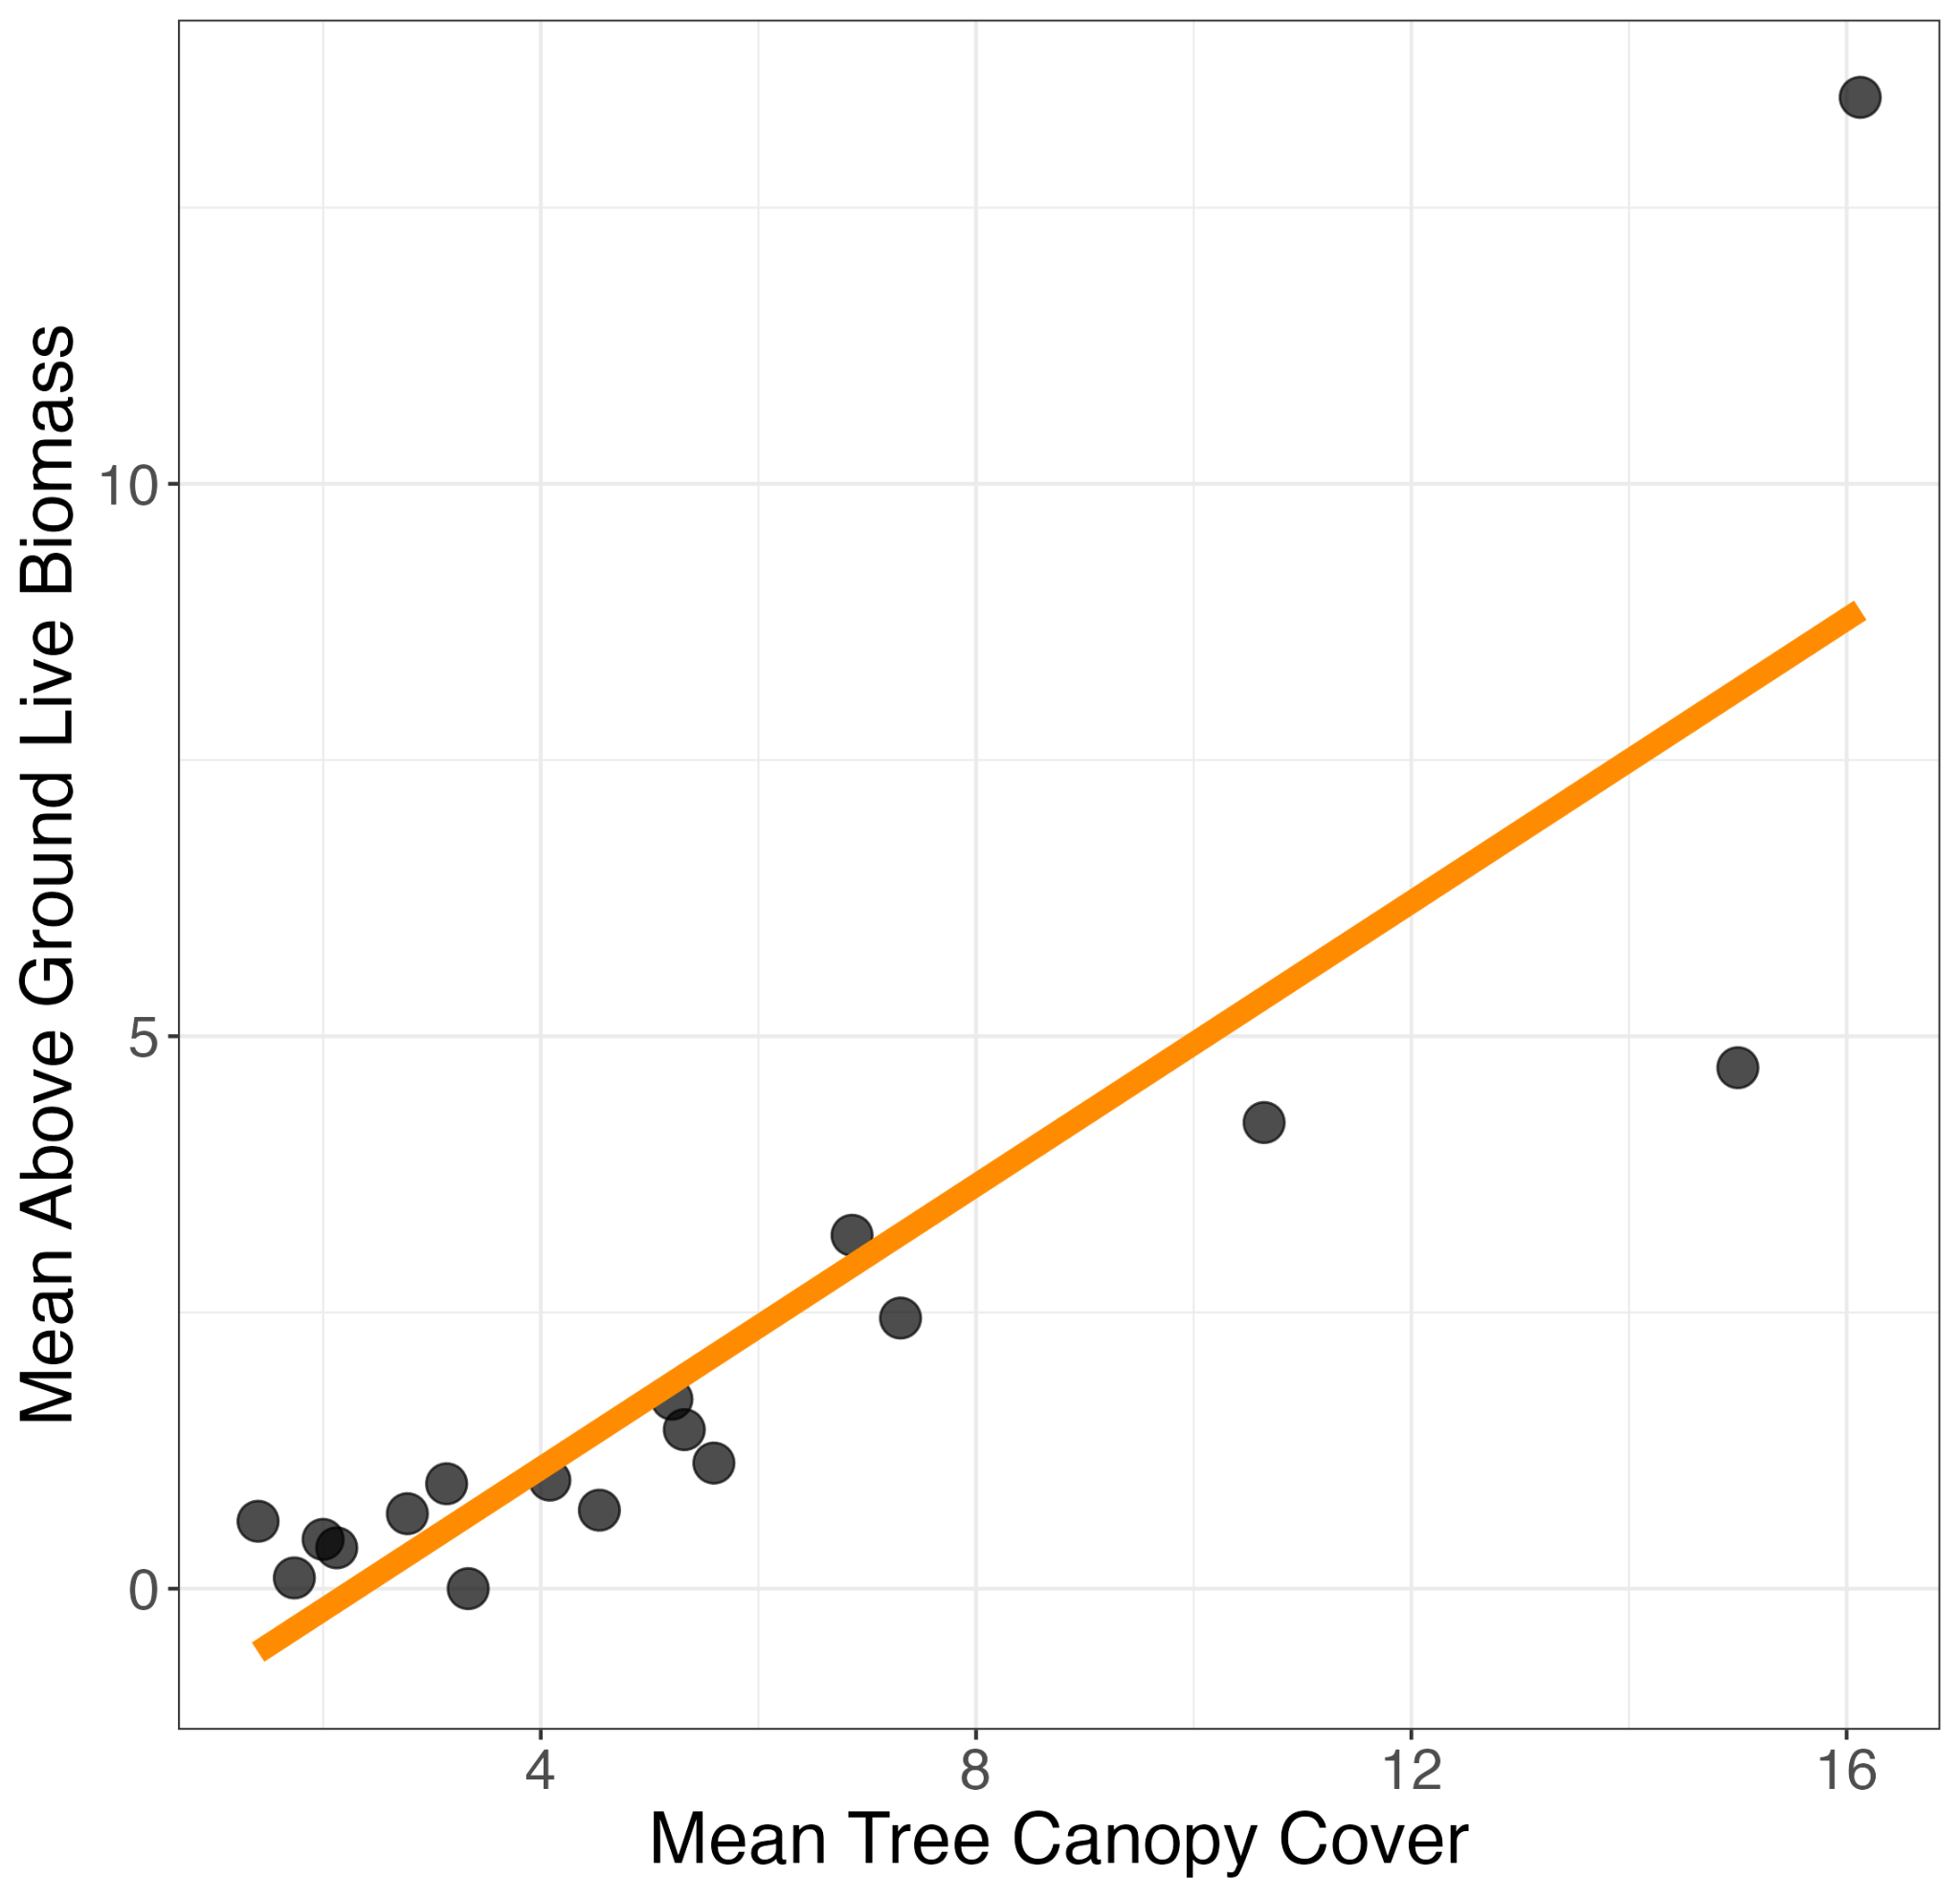
Unit-level linear model
Area-level linear model
Notes:
Want something that fits data better than unit level model, leverages more of the available data than the area level model, but remains interpretable

Slide 10
Zero-Inflation Estimator
(a two stage model)
Notes:
Stress that this is an estimator that aims to resolve the model mispecification issues when zero-inflation exists, and not to be *the* estimator that is applied CONUS wide.

Slide 11
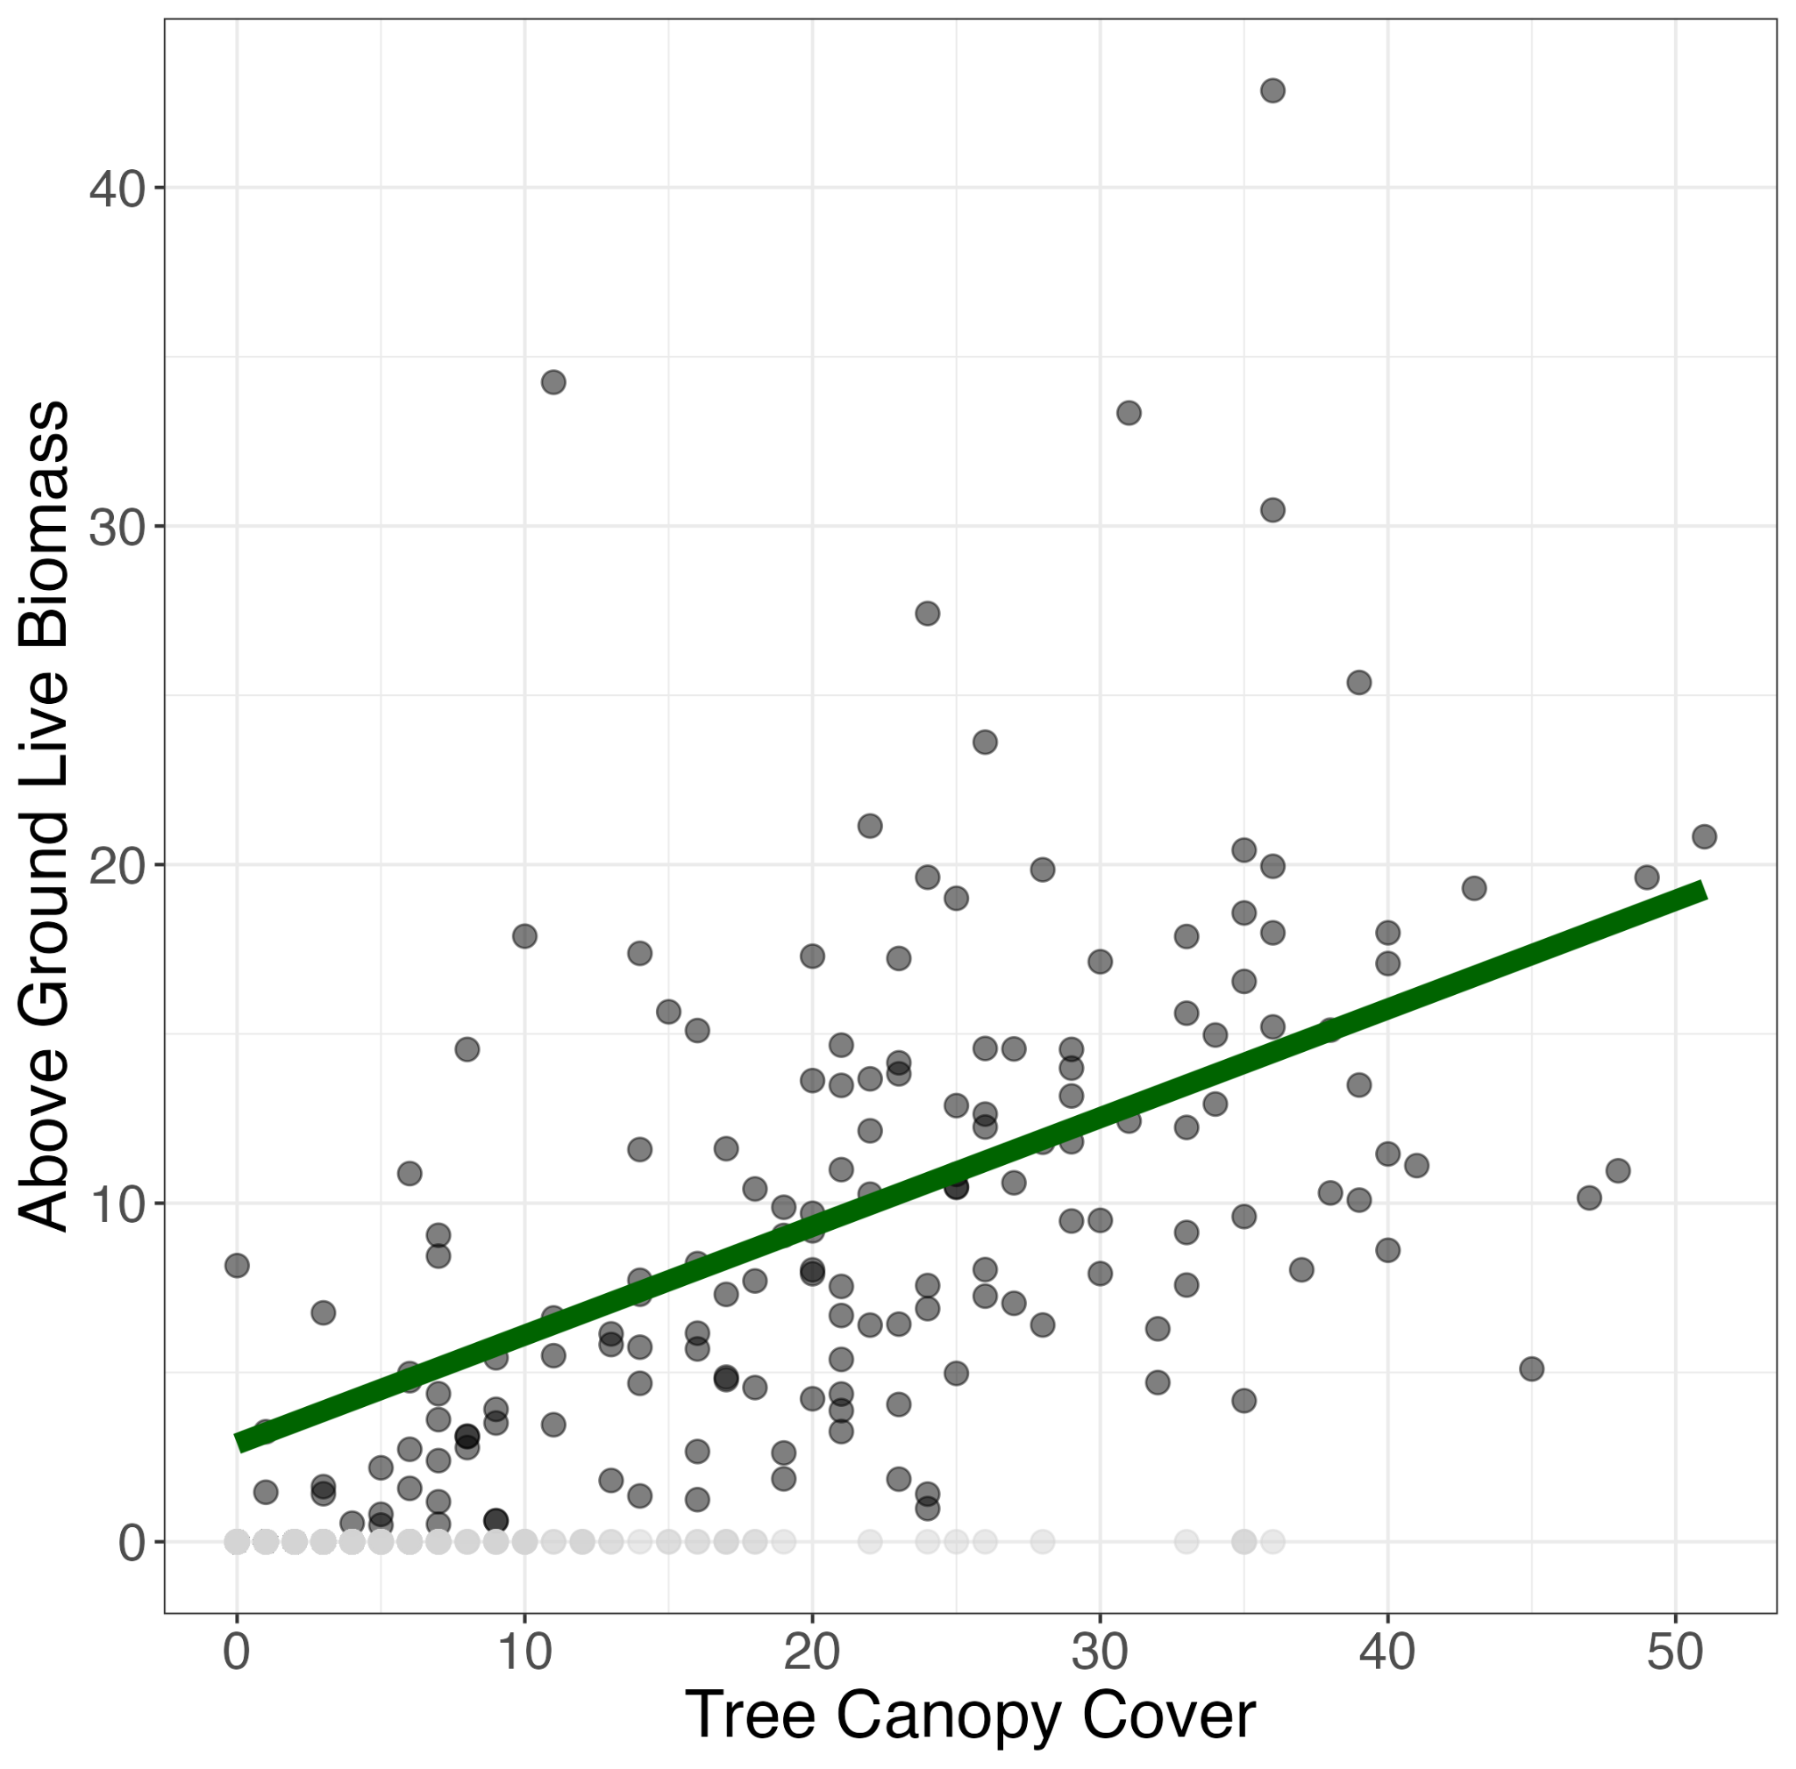
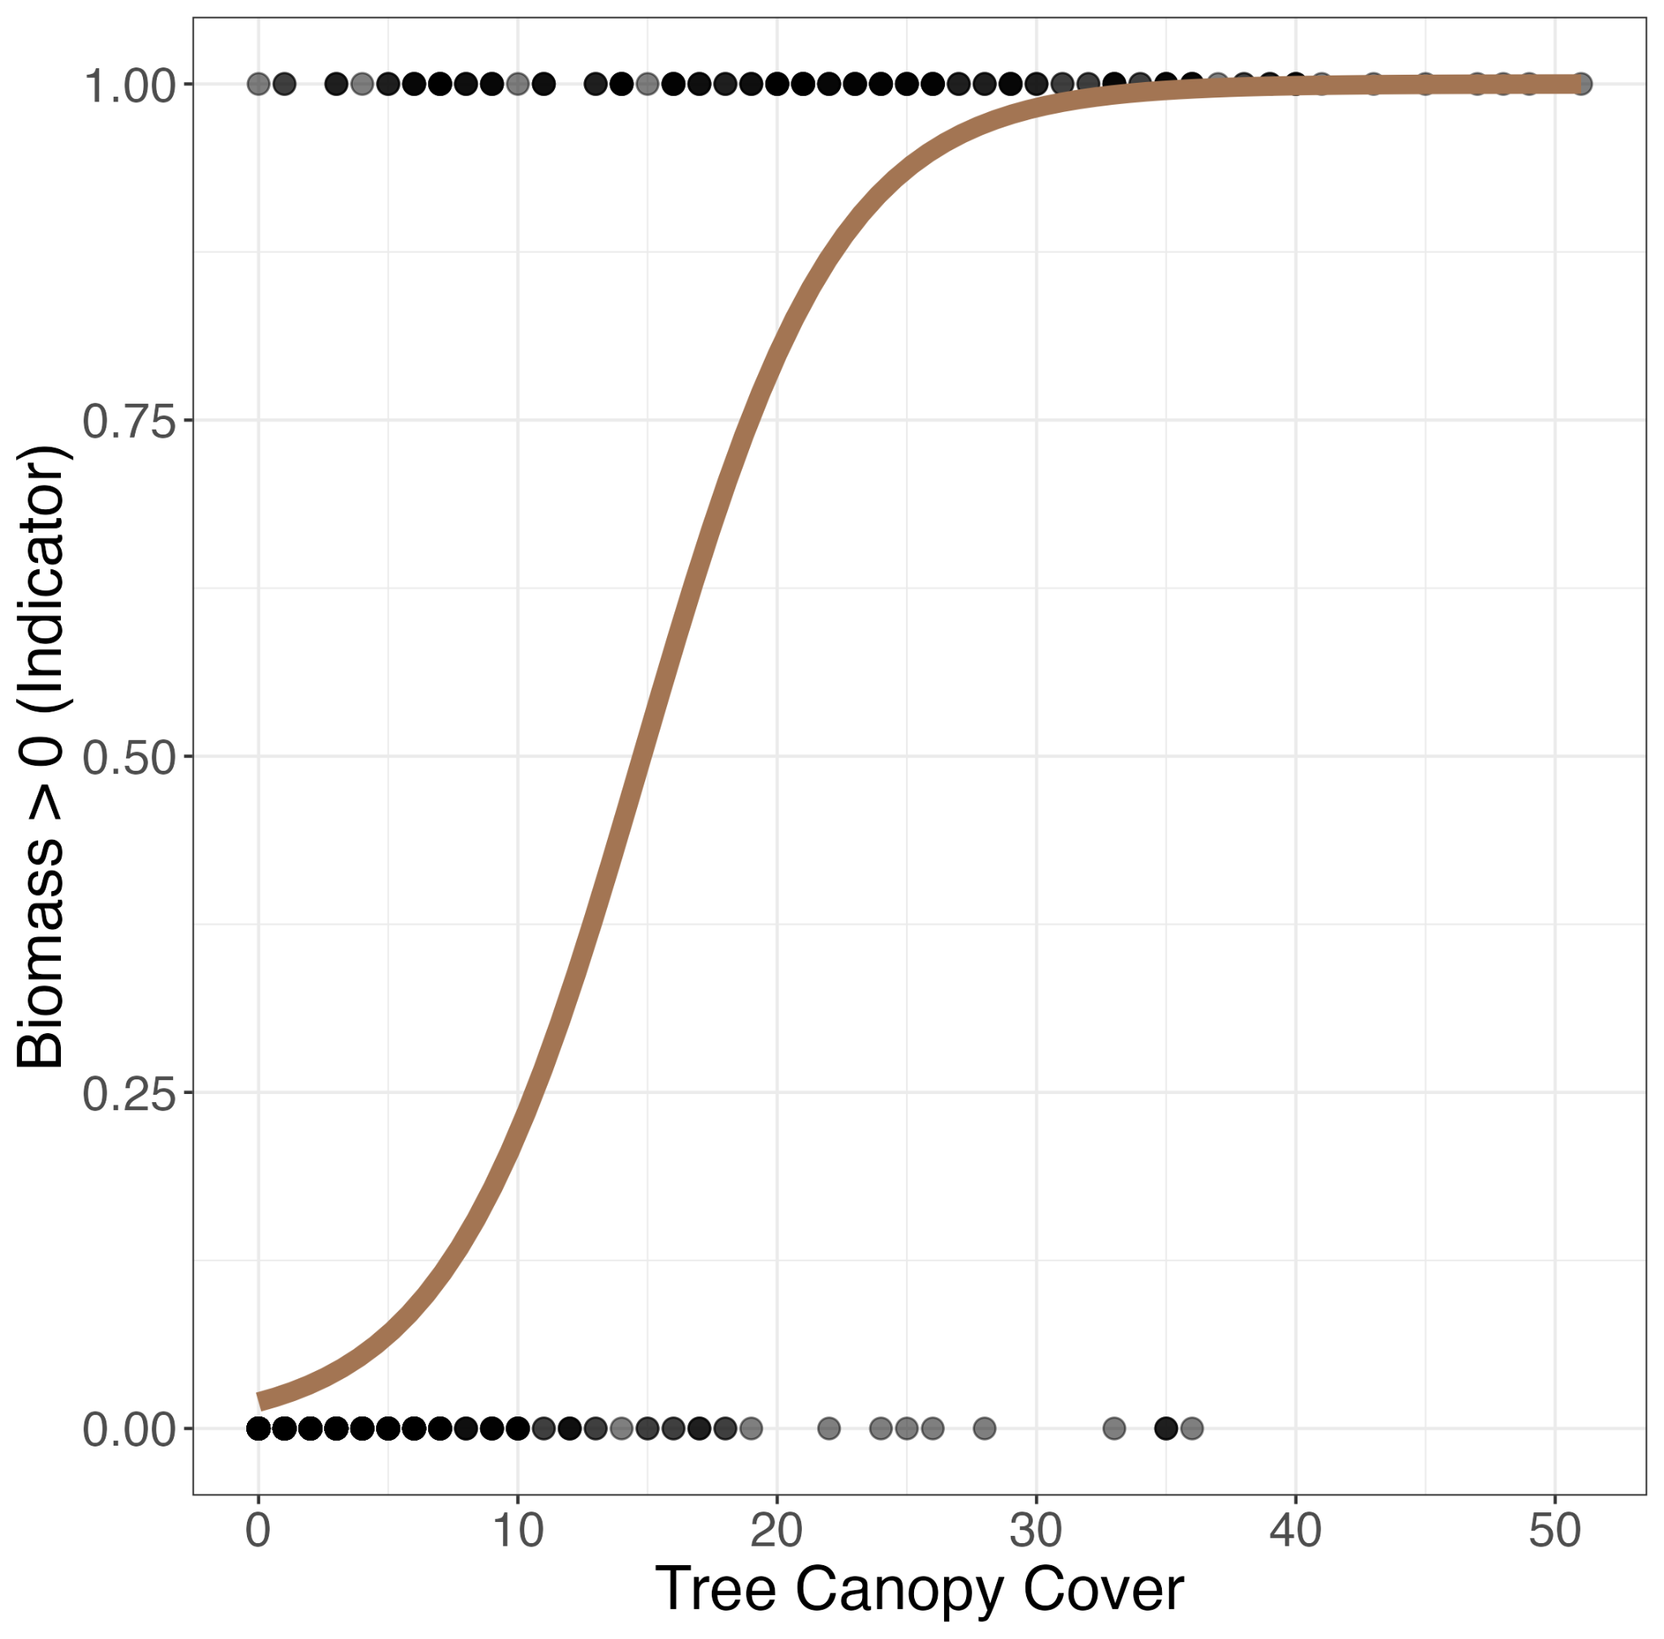
Linear model fit to the non-zero plots. Predicting biomass.
Generalized linear model with binomial response fit to all plots. Predicting P(biomass > 0)

Slide 12
Combining the two models
Prediction
for new unit i
= [estimated biomass in unit i]
x [estimated probability that unit i
has nonzero biomass]
Estimated from linear mixed model fit to non-zero plots
Estimated from logistic mixed model fit to all plots
The prediction from the first model is “weighted” by how likely the second model thinks that the plot has non-zero biomass.
Notes:
Still want to leverage the usually strong relationship between aux data and biomass in the non-zero plots. Logistic model will silence the bad predictions from the linear model

Slide 13
Notation
U represents our finite population with N pixels
i: indexes an individual unit
j: indexes a domain
x_ij: is our design matrix at the plot level
X_ij: is our design matrix at the pixel level
Notes:
Because we’re doing SAE we predict out onto the population

Slide 14


Individual Models
Linear mixed model:
Logistic mixed model:
u_j and w_j are domain level random effects
Notes:
Asterisk is just denotes that this model was fit to the non-zero plots

Slide 15


Prediction
Models are fit at the plot-level but prediction happens on each pixel in the population.
Pixel-level predictions are then aggregated to the domain level to get a small area estimate.
Notes:
These are small area estimates of the mean

Slide 16
Uncertainty estimation
To estimate the MSE of our estimator we implement the parametric bootstrap first introduced by Chandra and Sud (2012)
Parametrically generates a bootstrap pixel-level population.
Generates B-many bootstrap samples from it.
Fits the zero-inflation estimator to each sample.
Attains MSE estimates by comparing results to bootstrap population domain means.
Notes:
intuition

Slide 17
Simulation Study
Treated all Nevada FIA plots as our population
Created 1000 samples from this population
Sampled 3% of FIA plots in each county to create a single sample
This percent was empirically chosen as it produces roughly 20 plots per county for each sample.
Used these 1000 sample data sets to evaluate the following estimators:
Post-Stratified, Area-level EBLUP, Unit-level ELUP, zero-inflation
Notes:
Tnt for poststrat and tcc + elev for all other models. EBLUP is just a way of estimating the parameters in a linear mixed model

Slide 18
Results

Slide 19
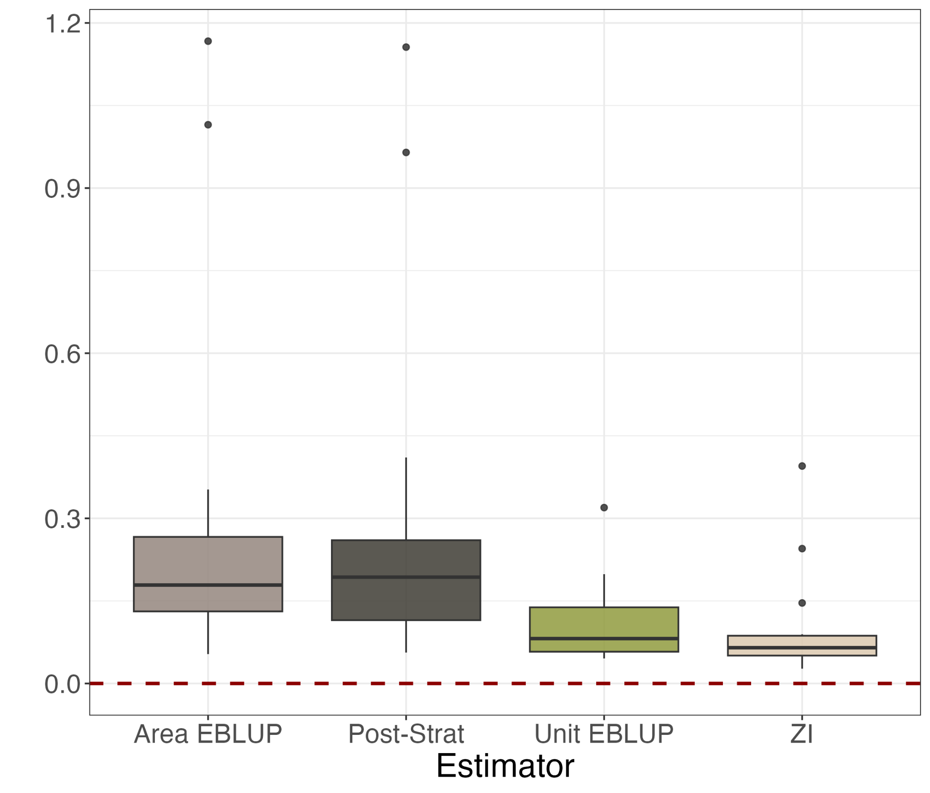
Root
Mean
Squared
Error

Slide 20
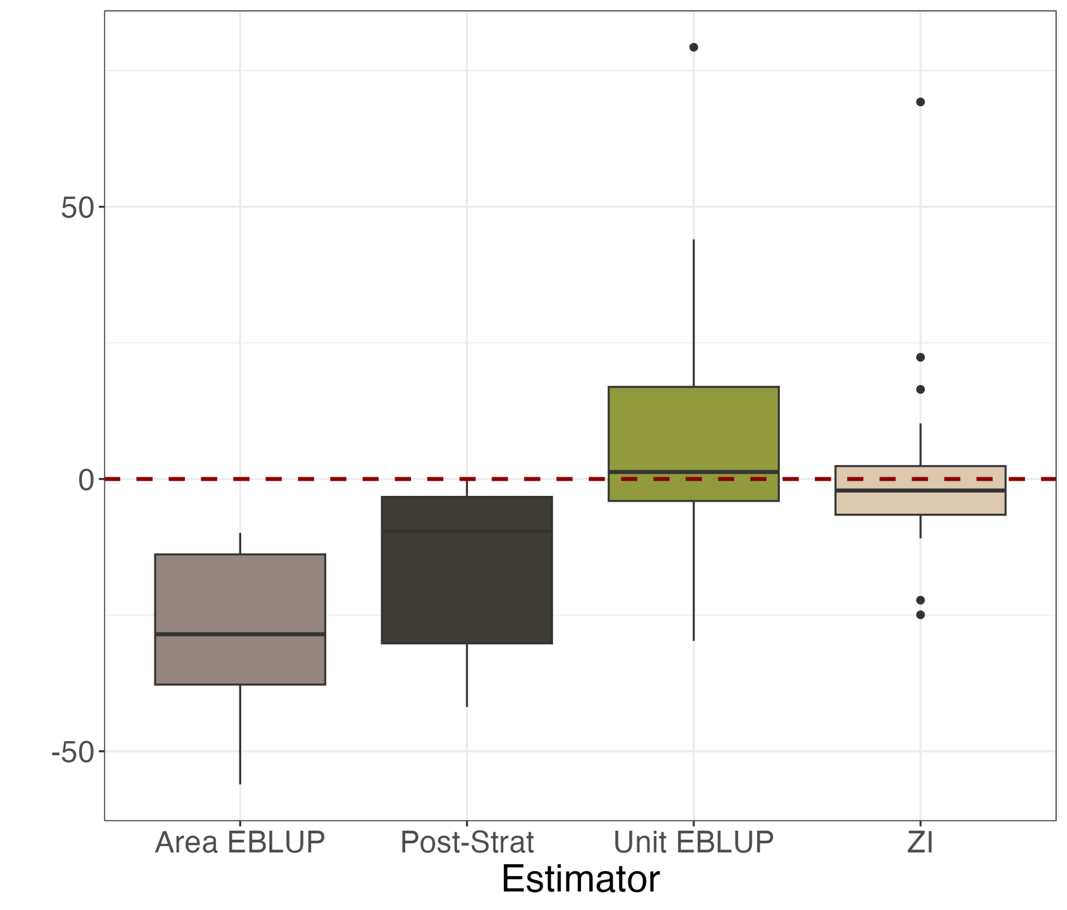
Percent
Relative Bias
Notes:
Computed bias for each county that’s why we have boxplots

Slide 21
Takeaways
Zero-Inflation can accurately quantify average biomass in regions with mixed land cover types.
Simulation study was run in a setting favorable to the zero-inflation estimator.
We don’t expect it to perform well in every situation (i.e entirely forested areas).

Slide 22
Thank you!

